Slide 1
FOODBOOK
By: Gregory Haynes and Paul Cheruvillil
http://ectweb.cs.depaul.edu/ghaynes1/Homepage.php
http://ectweb.cs.depaul.edu/pcheruvi/Homepage.php

Slide 2
Technologies Used
The technologies that we used on this project were HTML, CSS, JavaScript/jQuery, PHP, and Bootstrap.
Along with the JavaScript, we enabled cookie logic to be working on this site as well.

Slide 3
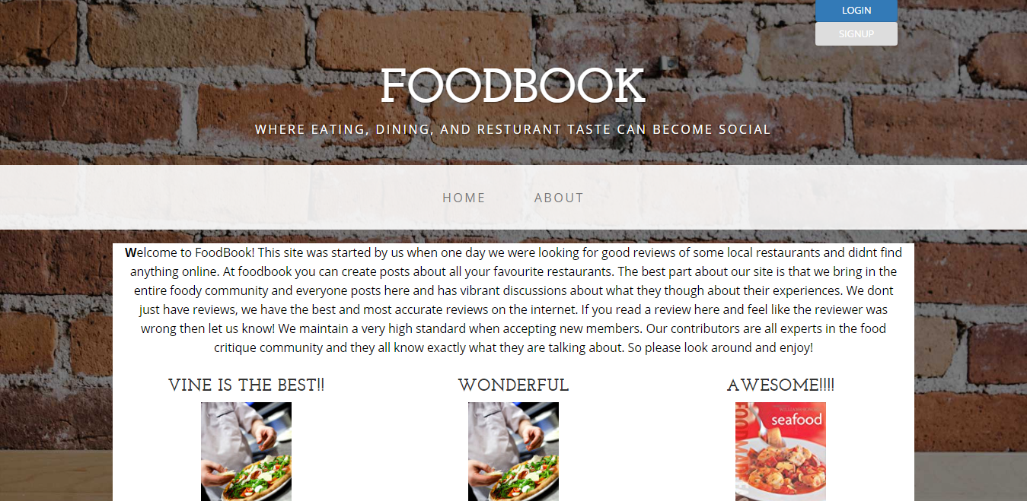
Why We Chose to Create the FOODBOOK Site
We chose to create this site because we wanted to give a social restaurant experience to different users.

Slide 4
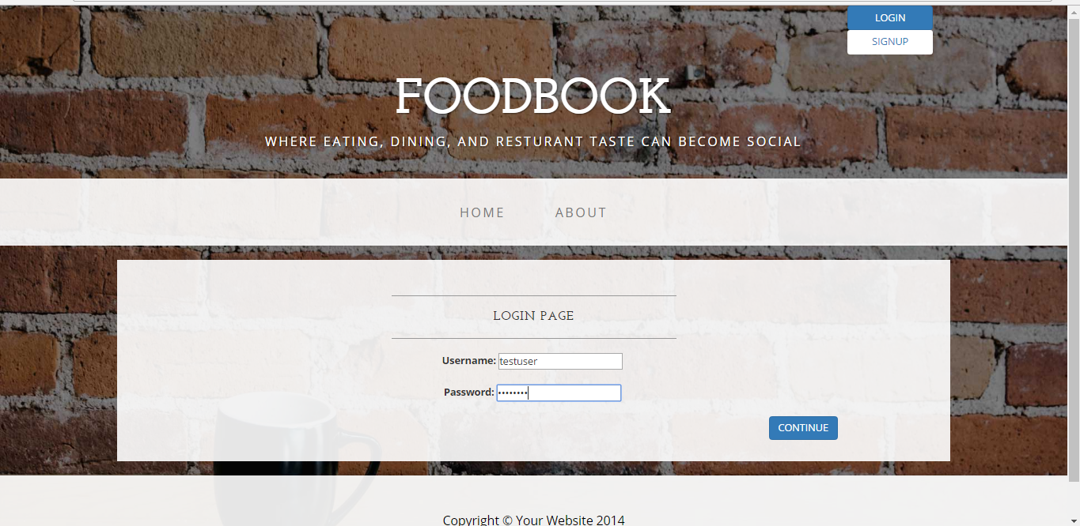
Login Page
When the user logs into the site, they are brought to a message that says “Thank you for logging in”, and then they are redirecting to the Restaurant category page.
In addition to this page, the user can login and logout any time they want to.

Slide 5
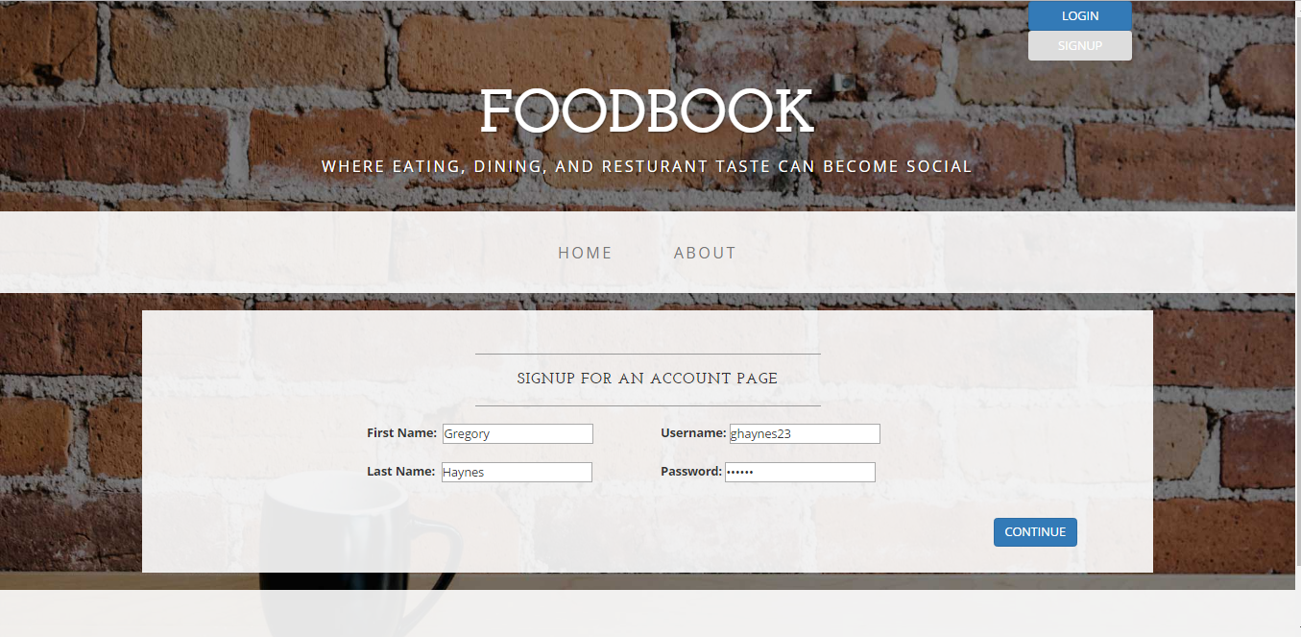
Registration Page
How the registration page works is that the user will register for the site. Once they register, they’ll be redirected to the Restaurant category page.

Slide 6
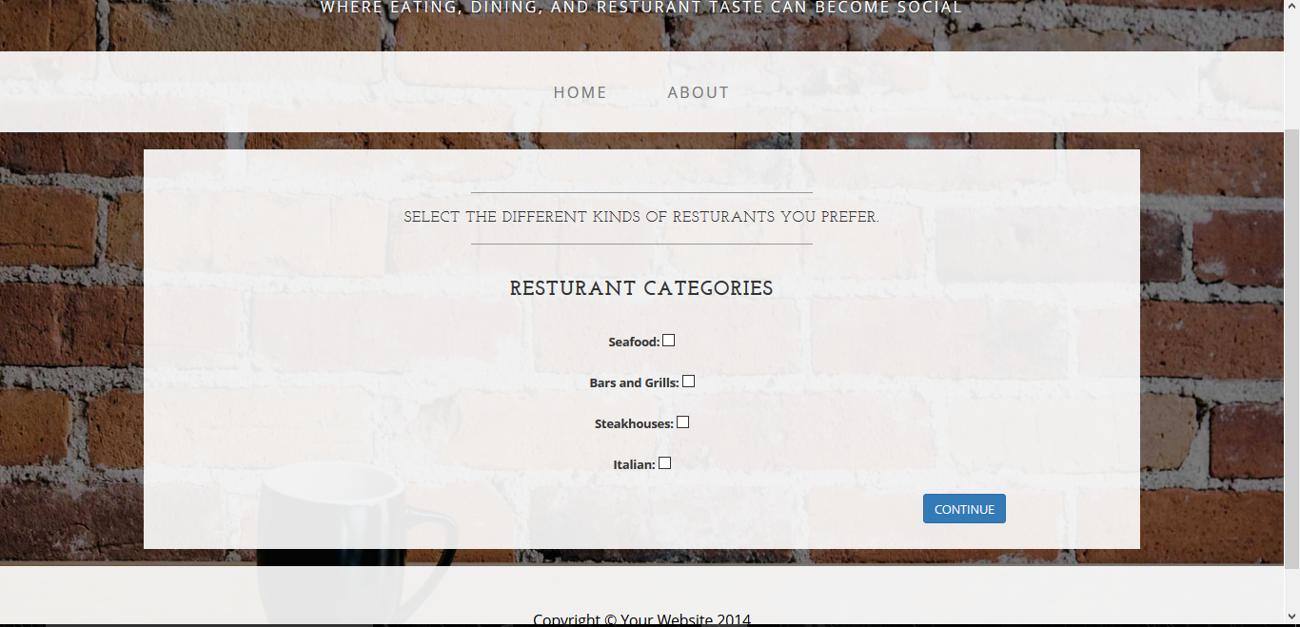
Restaurant Categories Page
On the Restaurant Categories page, the user selects the type of restaurants that they’re into and they click Continue to see those results displayed.

Slide 7
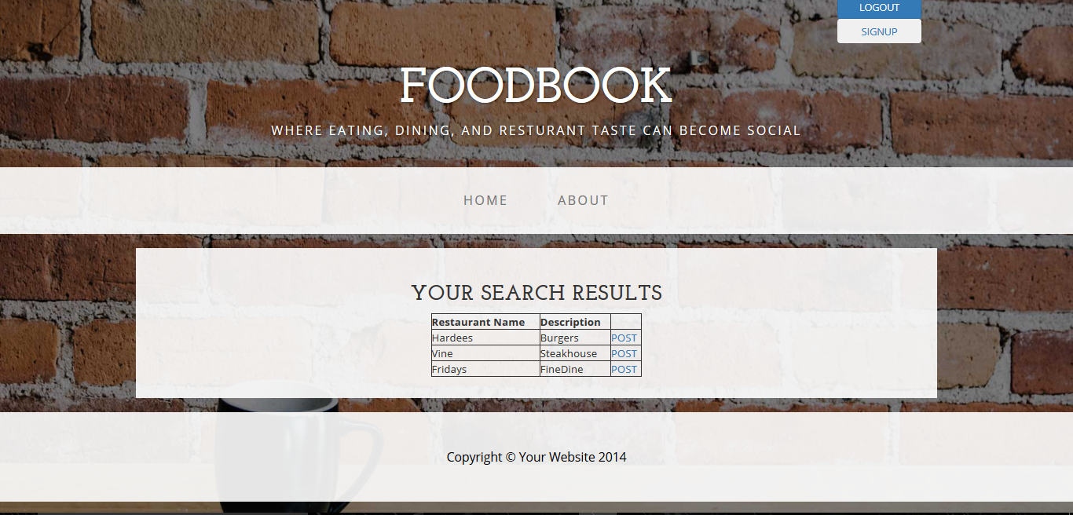
View Results Page
When the user selects the kinds of restaurants they want, a search result list will appear for the restaurant categories.

Slide 8
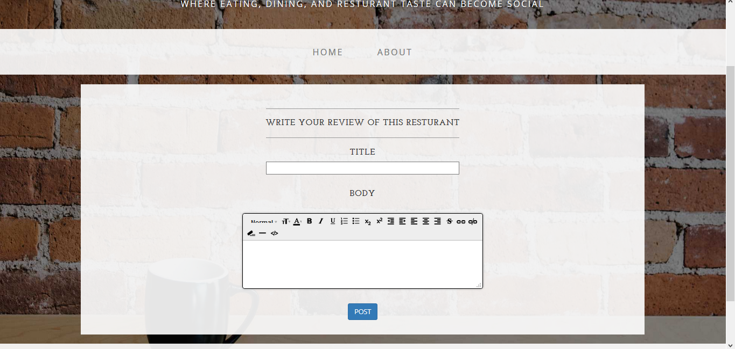
Create Post Page
The user clicks on the POST link and is directed to the Create Post page.

Slide 9
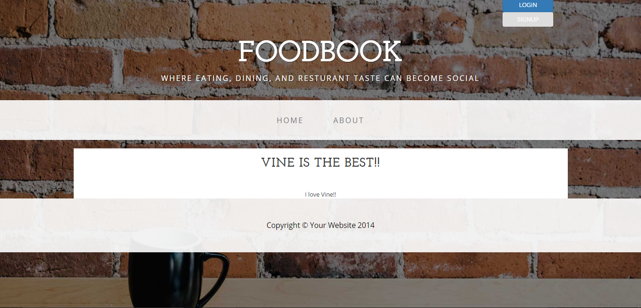
View Article Page
When the user writes their review, it gets posted onto the Homepage and there, the user can read their article that they’ve posted.

Slide 10
The End
In Conclusion, that is a basic overview of how our site works.

